Slide 1

YOUTUBE CLONE

Slide 2
Team Members
N190422 - P. BUJJI
N190897 - B. SRUTHI
N190201 - B. NAGARANI
N191106 - R. UMADEVI
N190396 - B. PRAVALLIKA

Slide 3

Table of contents
Abstract
Introduction
Technologies Used
Hardware and Software Components
Code
Output
Conclusion
References

Slide 4
abstract
The YouTube Clone Project aims to develop a web-based platform that replicates the core functionalities of YouTube. This platform allows users to search videos and view them. It also includes features for video categorization, search functionality, and personalized recommendations.
Key components of the project include:
Video Playback: A robust video player supporting various formats and resolutions, with controls for play, pause, seek, volume adjustment, and fullscreen mode.
Search and Discovery: Advanced search capabilities with filters for video categories. Personalized recommendations based on user behavior and preferences.
Responsive Design: A user interface that adapts seamlessly to different devices and screen sizes, ensuring a consistent experience across desktops, tablets, and smartphones.
Scalability and Performance: Efficient handling of large volumes of data and concurrent users, with backend optimizations for performance and scalability.

Slide 5
The project utilizes modern web development technologies, including HTML, JavaScript, Material UI, React JS, React Player and rapidAPI Youtube v3.
Through this project, we aim to deliver a user-friendly and efficient front end design and React Router DOM for smooth navigation. With the help of the RapidAPI YouTube v3, we've integrated real-time data fetching from YouTube's vast library of videos, allowing users to seamlessly browse and watch their favorite content

Slide 6
Introduction
The YouTube Clone Project leverages modern web development technologies to achieve these goals. We utilize HTML, JavaScript, and Material UI for building a dynamic and intuitive front-end interface. React.js and React Player are employed for creating interactive components and video playback functionality, while React Router DOM facilitates smooth navigation within the platform.
Central to our implementation is the integration with RapidAPI's YouTube v3, which allows real-time data fetching from YouTube's extensive video library. This integration provides users with access to a vast array of videos, enhancing the overall user experience by enabling seamless browsing and watching of their favorite content.
Through this project, we aim to deliver an efficient and engaging video-sharing platform that showcases the capabilities of modern web technologies. Our focus on user experience, performance, and scalability ensures that the YouTube Clone Project not only replicates YouTube's core functionalities but also provides a robust foundation for future enhancements and innovations.

Slide 7
Technologies USED
React.js:
React.js is a popular JavaScript library developed by Facebook for building user interfaces, particularly single-page applications. It allows developers to create reusable UI components, making it easier to manage complex applications. React's virtual DOM improves performance by updating only the parts of the page that have changed, rather than reloading the entire page. This efficiency, along with its component-based architecture, makes React.js a preferred choice for developing dynamic and responsive web applications.
Material-UI:
Material-UI is a comprehensive library of React components that implement Google's Material Design guidelines. It provides a wide range of pre-designed and customizable UI components, such as buttons, sliders, and grids, which help developers create visually appealing and consistent user interfaces. Material-UI enhances the development process by offering components that are both flexible and easy to integrate, ensuring a polished and professional look for the application.

Slide 8
Technologies used
React Router DOM:
React Router DOM is a routing library for React applications, enabling navigation between different components and views without reloading the page. It manages the application's URL and renders the corresponding components, allowing for smooth transitions and deep linking. React Router DOM supports nested routes, dynamic route matching, and easy access to route parameters, making it a powerful tool for building single-page applications with complex navigation requirements.
RapidAPI YouTube v3:
RapidAPI YouTube v3 is an API service that provides access to YouTube's extensive video library. It allows developers to fetch real-time data from YouTube, including video details, search results, and user information. By integrating RapidAPI YouTube v3 into the application, developers can offer users a rich video browsing experience, leveraging YouTube's vast content database. This API facilitates seamless data retrieval, ensuring that users can search for and watch videos effortlessly.

Slide 9
Technologies used
React Player:
React Player is a flexible media player component for React applications, supporting various media formats including YouTube, Vimeo, SoundCloud, and more. It provides a simple API for embedding and controlling media players within a React application. With features like play, pause, seek, volume control, and fullscreen mode, React Player ensures a smooth and customizable media playback experience. Its ease of integration and support for multiple media sources make it an ideal choice for building rich multimedia applications.

Slide 10
Hardware and software requirements
Minimum Hardware requirement:
RAM : 4GB
Storage: HDD or SSD with sufficient storage
System type: 64-bit
Minimum Software requirements:
Operating System: Windows 8 and above
Programming Language : React JS, JavaScript
Other Technologies : Api’s, HTML, Material UI,
IDE: Visual Studio Code

Slide 11
Code
App.Js:
import { BrowserRouter, Routes, Route } from "react-router-dom"
import { Box } from "@mui/material"
import {ChannelDetail, Feed, Navbar, SearchFeed, VideoDetail} from './components'
const App = () => (
<BrowserRouter>
<Box sx={{backgroundColor: "#000"}}>
<Navbar/>
<Routes>
<Route exact path="/" element={<Feed/>}/>
<Route path="/video/:id" element={<VideoDetail/>}/>
<Route path="/channel/:id" element={<ChannelDetail/>}/>
<Route path="/search/:searchTerm" element={<SearchFeed/>}/>
</Routes>
</Box>
</BrowserRouter>
)
export default App

Slide 12
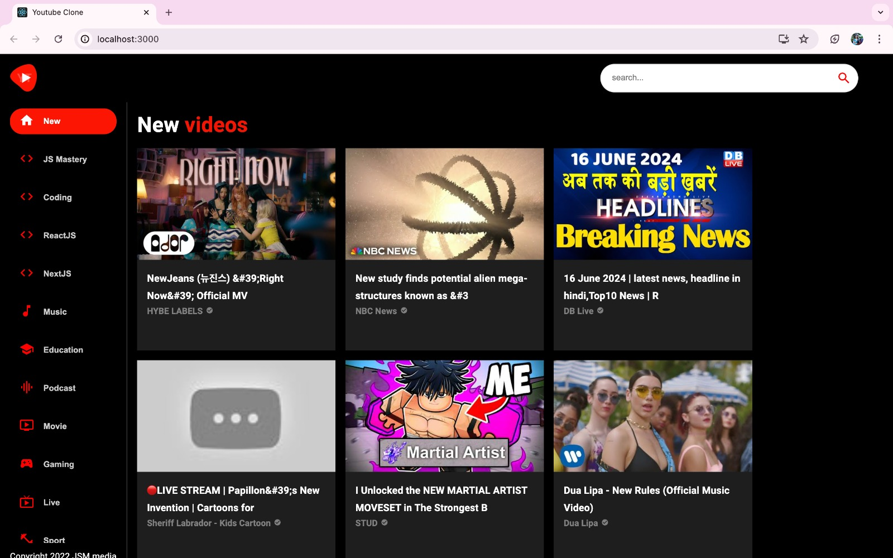
output

Slide 13
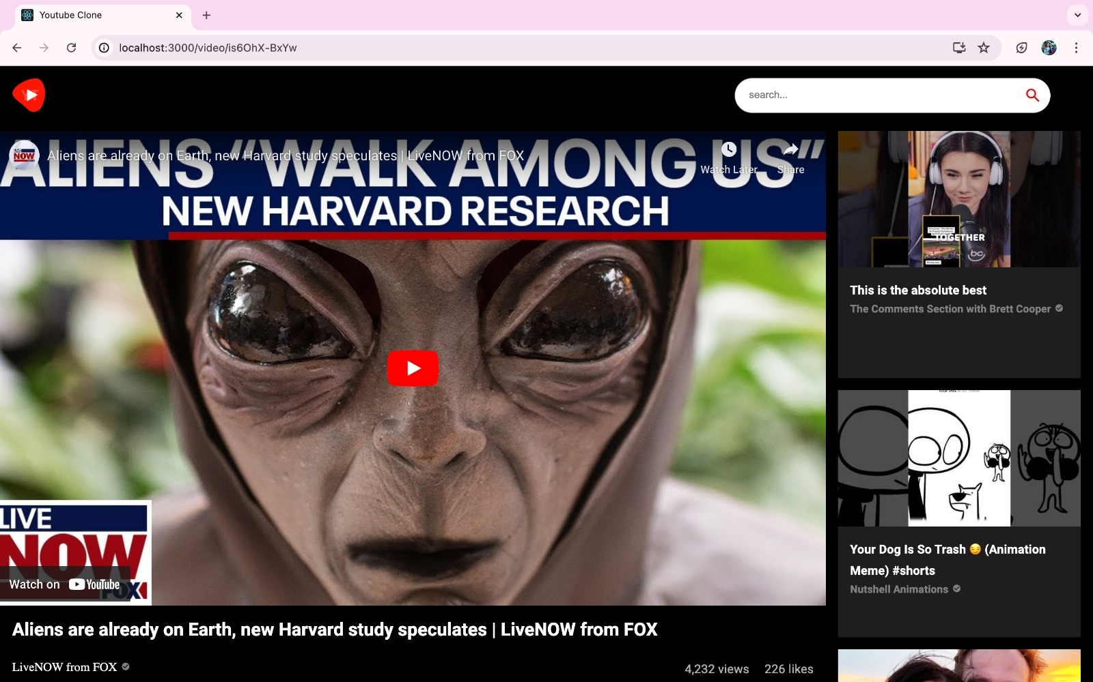
output

Slide 14
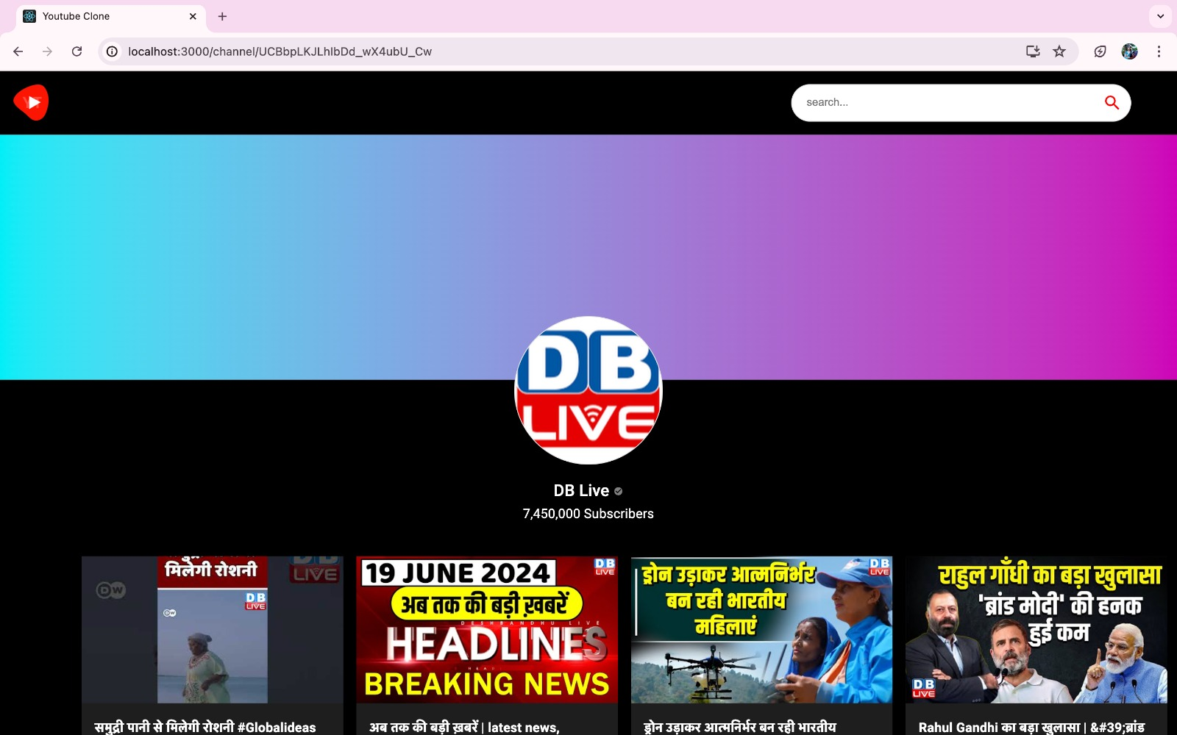
output

Slide 15
Conclusion
The YouTube Clone Project represents a comprehensive effort to replicate and enhance the core functionalities of YouTube through modern web development technologies. By leveraging HTML, JavaScript, Material UI, React.js, and the RapidAPI YouTube v3, the project aims to deliver a robust platform with a user-friendly front end design and seamless navigation using React Router DOM.
Key components such as the robust video player supporting various formats and resolutions, advanced search capabilities with personalized recommendations, and responsive design ensure a consistent and engaging user experience across different devices. The emphasis on scalability and performance optimizations ensures efficient handling of large datasets and concurrent users, making the platform capable of meeting growing demands.
Ultimately, the project strives to offer users a familiar yet enhanced experience akin to YouTube, enabling seamless video playback, efficient video discovery through advanced search and recommendation features, all while maintaining high standards of performance and scalability.

Slide 16
Future scope
Technology and Scalability: Ensure our platform can handle growth. Scalability is critical as user numbers and content volume increase.
User Experience : Prioritize intuitive design and responsive features. A positive user experience encourages engagement and retention

Slide 17
References
Youtube
Github

Slide 18
Thank you

